Slide 1
C# Workshop
Selenium Test Automation
Maciej Wyrodek

Slide 2
Sort Cards on the table
what do you think is true and which are not

Slide 3
Workshop Plan
Programming basics.
Programming Concepts.
Automation basics.
Test automation Design.

Slide 4
Workshop day 1

Slide 5
Day 1 - Programming Basics
1. Visual Studio and its functions
2. data tapes, variable, methods, etc
3. Programming

Slide 6
What are your goals?
What do you want to learn?

Slide 7
Why do Testers need to know how to code?

Slide 8
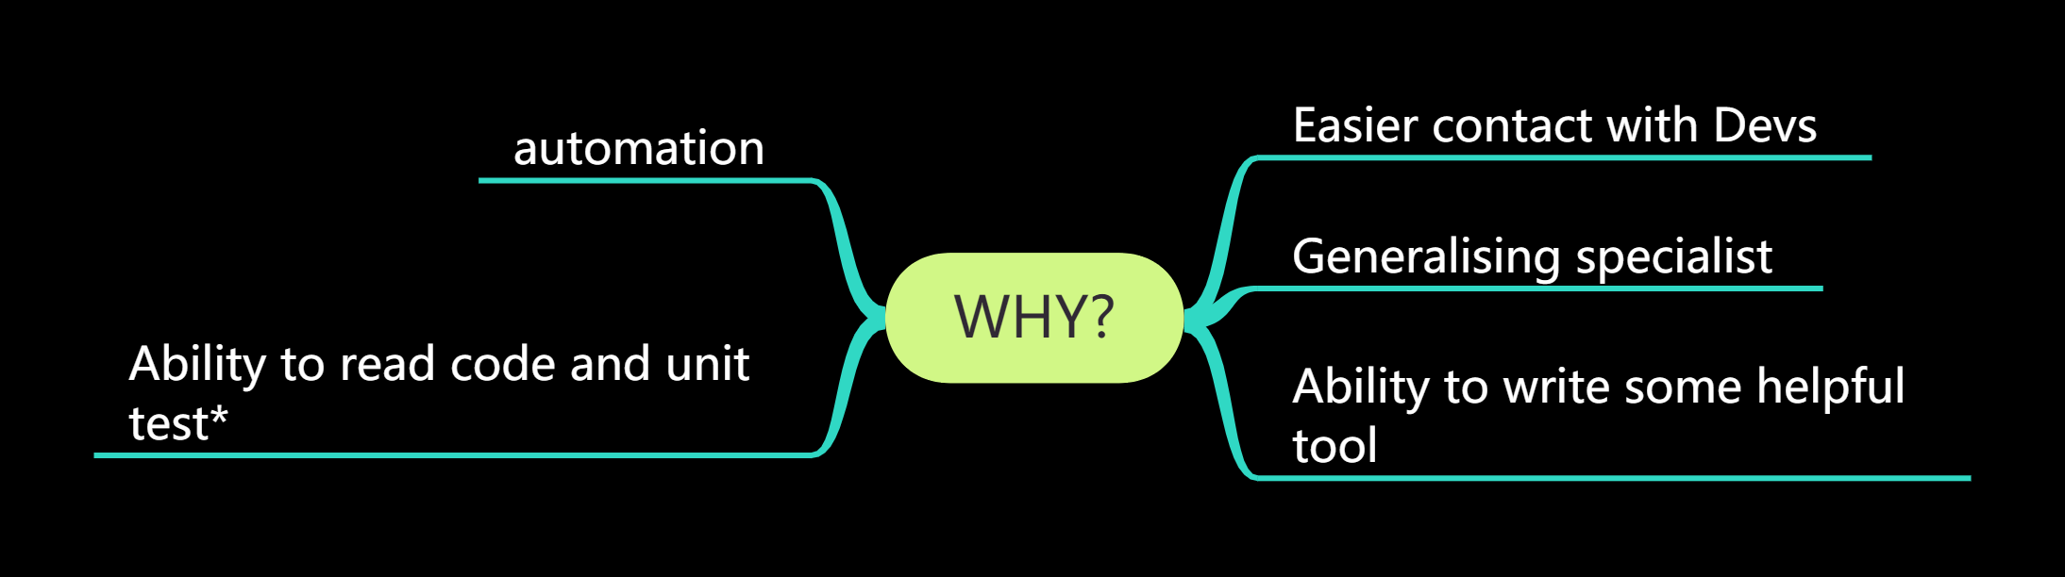

Slide 9
YOU NEED A MENTOR!

Slide 10
YOU NEED A MENTOR!
The 4-day workshop is just a start on your journey,

Slide 11
What I will help you with:
I will get you enough knowledge to start.
I will point you where to find more info.
I will point you where to start.
I will help you get some practice

Slide 12
GIT

Slide 13

EX 1 - Setup Git
1. Ho to GitHub com and created your account (you can delete it later)
2. Go to https://github.com/mwyrodek/csharp_workshop
and fork it
3. Install git extensions
4. Clone your fork

Slide 14
Fork
The fork is a copy of a repository. Forking a repository allows you to experiment and changes without affecting the original project.

Slide 15
Commit vs push
Open your local copy of repository
Open readme
Add some info there.
Commit it (commit not push) to your repo.
Go to your fork on GitHub.
Check if your text is in a readme.
Push your changes.
Check now.

Slide 16
Revert commit
Do some changes to readme.
Commit your changes
Open your previous commit in git extension.
Revert your branch to that..
Check file content

Slide 17
Revert
Revert allows you to return to previous commits
revert is not recommended on already Pushed changes!

Slide 18
Commit Often
push only when you are ready!

Slide 19
Branches
create new branch
Commit and push some changes
Switch back to master branch.

Slide 20
Branches
Branches are useful for experiment and working on many tasks at once.
For example, branch per developer or per task/story.

Slide 21
Branches
Add fork of your friend as remote repository
Commit and push some changes
Try to marge his readme changes with yours.
both make conflicting changes to readme
try to merge now.

Slide 22
Commit Often
push only when you are ready
But oush to your branch/fork
before leaving work

Slide 23
Let’s talk about programing!

Slide 24
Open VS!

Slide 25
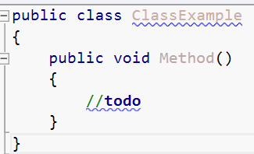

Slide 26
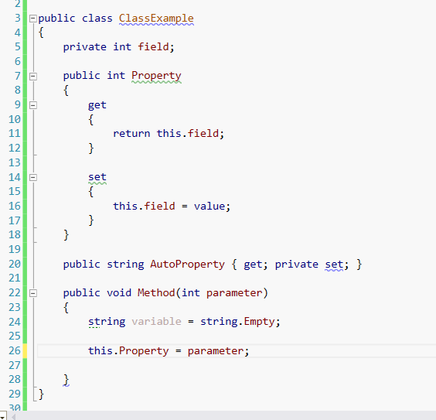

Slide 27
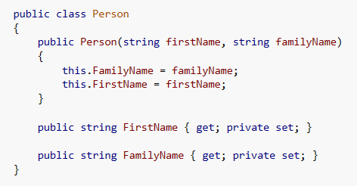

Slide 28
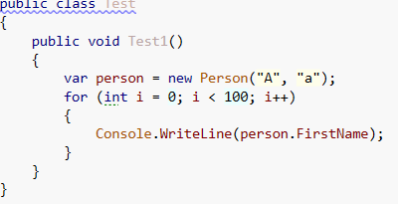
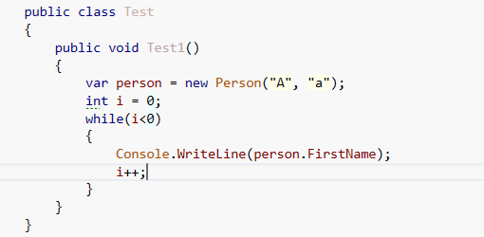

Slide 29
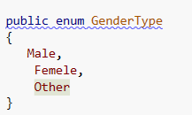
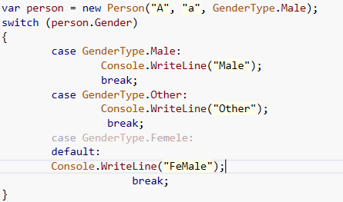
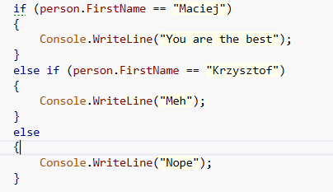

Slide 30
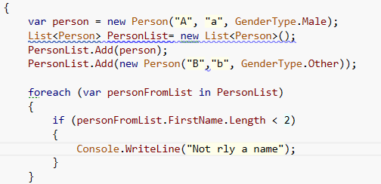

Slide 31
Workshop day 2

Slide 32
Object-oriented Programming

Slide 33
Pillars of OOP
Abstraction
Encapsulation
Inheritance
Polymorphism

Slide 34
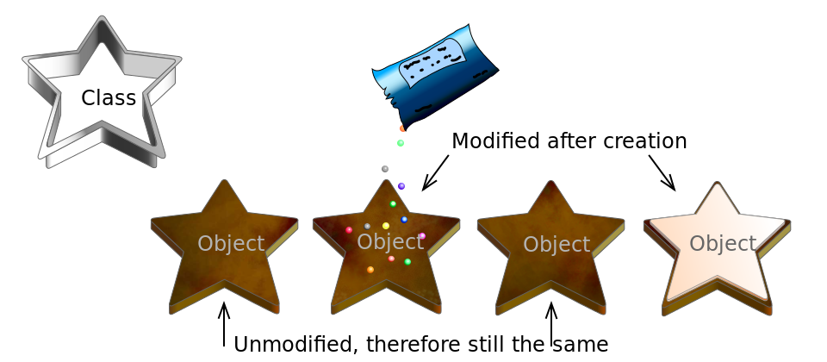
Class and Object

Slide 35
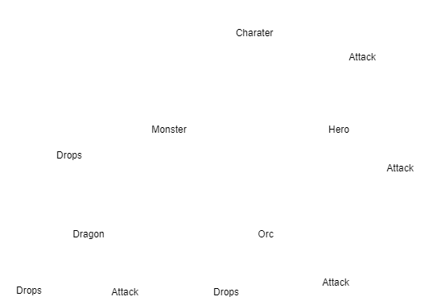
Abstraction

Slide 36
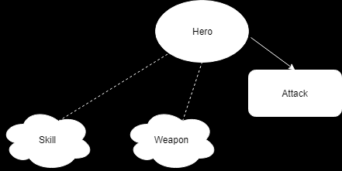
Encapsulation
Attack = Skill + Weapon

Slide 37
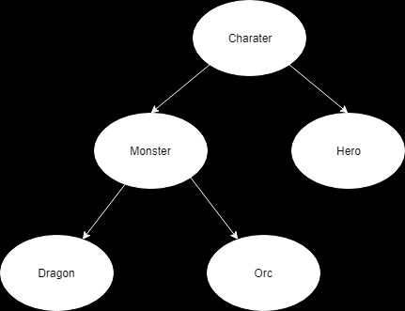
Inheritance

Slide 38
Polymorphism
loot = Dragon.Loot()
loot = Orc.Loot()

Slide 39
SRP - Single Responsibility Principle

Slide 40
DRY- Don’t Repeat Yourself

Slide 41
TDD - Test Driven Development
Write Test
Run test
Write code
Run Test
Fix code

Slide 42
TDD - Test Driven Development
Write Test
Run test
Write code
Run Test
Fix code

Slide 43
Workshop day 3

Slide 44
Let’s Talk about Automation!

Slide 45
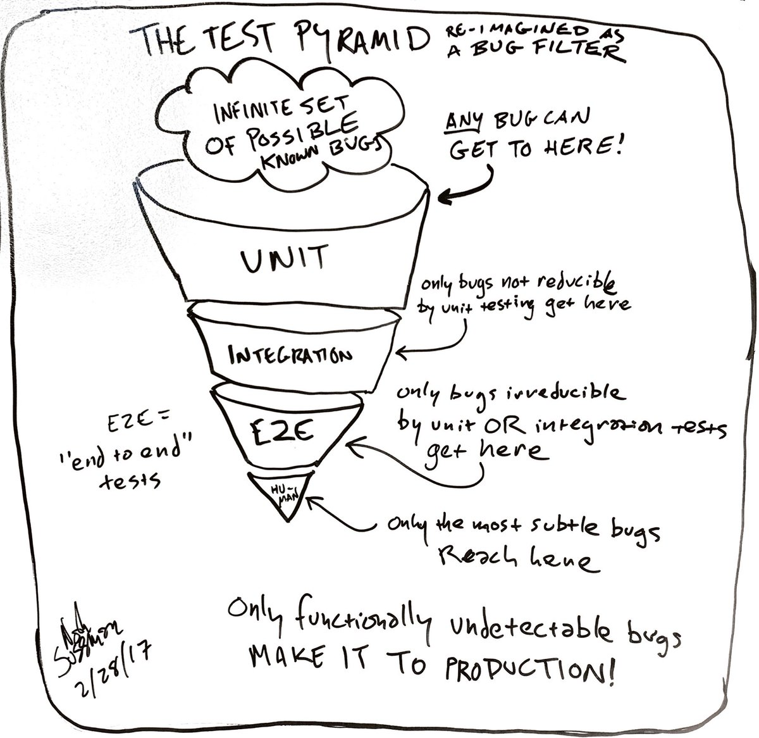

Slide 46
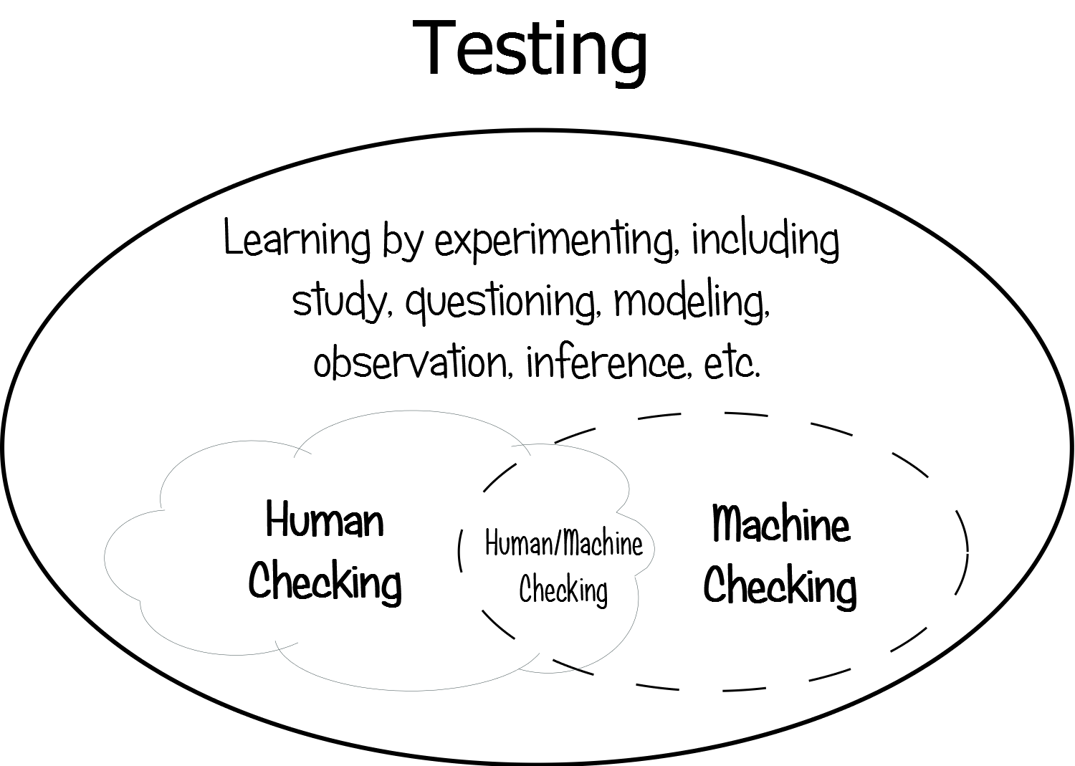

Slide 47
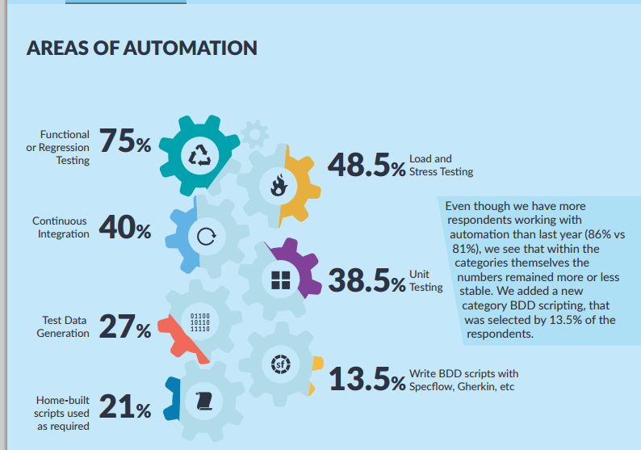

Slide 48
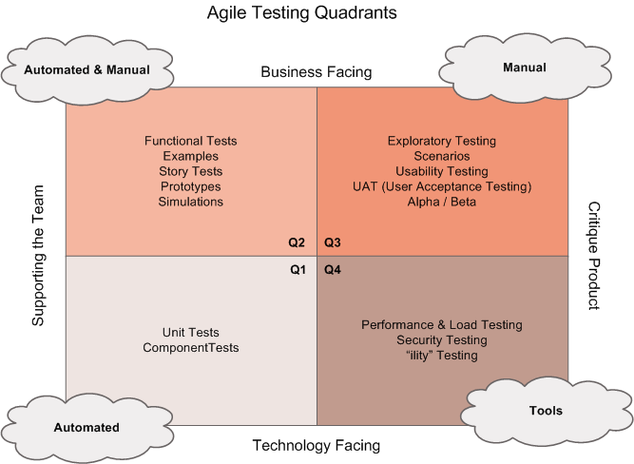

Slide 49
See Red After you’ve seen Green

Slide 50
Don’t invent wheel a new!
Use already existing frameworks

Slide 51
SELENIUM WEBDRIVER

Slide 52

SELENIUM WEBDRIVER

Slide 53
Example: https://github.com/ObjectivityLtd/Test.Automation
https://atata-framework.github.io/
https://github.com/TestStack/TestStack.Seleno (discontinued)
http://redwoodhq.com/
https://gauge.org

Slide 54
WEBDRIVER Standard:
https://www.w3.org/TR/webdriver/

Slide 55
LOCATORS
https://automatetheplanet.com/selenium-webdriver-locators-cheat-sheet/

Slide 56
Locator Order
ID
CLASS/NAME
CSS Selector
XPATH

Slide 57
PAGE OBJECT PATTERN

